Slide 1






Lecture 15:
Async/Await
Course - Web Development - II
-By
Instructor Name
Pratik Raj verma
‹#›
welcome@krmangalam.edu.in
Sohna Road,Gurugram,Haryana 122103

Slide 2

| Table of Contents
Async/Await
References.
The End.
‹#›

Slide 3

|
Do you know… if we have a lot of promise-based code and we want to make it wait properly, earlier we had to use callback hell — which was super messy.
Then we got promise chaining .then().then().then() — better, but still a bit hard to read.
Do you think something even better exists that can handle async code without callback hell or long promise chains?
‹#›

Slide 4

|
Do you know… if we have a lot of promise-based code and we want to make it wait properly, earlier we had to use callback hell — which was super messy.
Then we got promise chaining .then().then().then() — better, but still a bit hard to read.
Do you think something even better exists that can handle async code without callback hell or long promise chains?
The answer is… YES!
And a big thank you to our hero — async/await
It makes async code look clean and easy to read.
It’s like giving superpowers to your promises.
It lets you write asynchronous code as if it was synchronous
‹#›

Slide 5
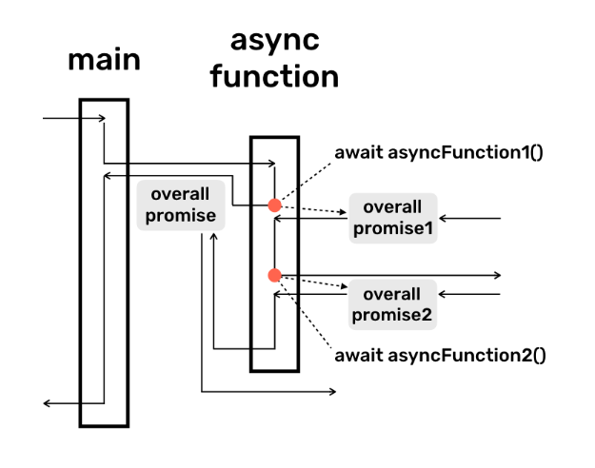
| async-await
async/await is a way to handle asynchronous code which return promises in JavaScript so that it waits for each task to finish before moving to the next, without using long .then() chains or falling into callback hell.
It allows you to write asynchronous code in a way that looks and behaves like synchronous code.
‹#›

Slide 6
| async-await
async: A keyword placed before a function declaration. It does
two things:
It makes the function implicitly return a promise.
It allows you to use the await keyword inside it.
await: Can only be used inside an async function. It pauses
the execution of the async function and waits for a
promise to resolve.
‹#›

Slide 7
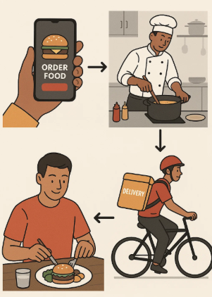
| async-await
Ordering Food Online (with Promises)
Steps:
Order food from app
Restaurant prepares it
Delivery person delivers it
You eat
‹#›

Slide 8
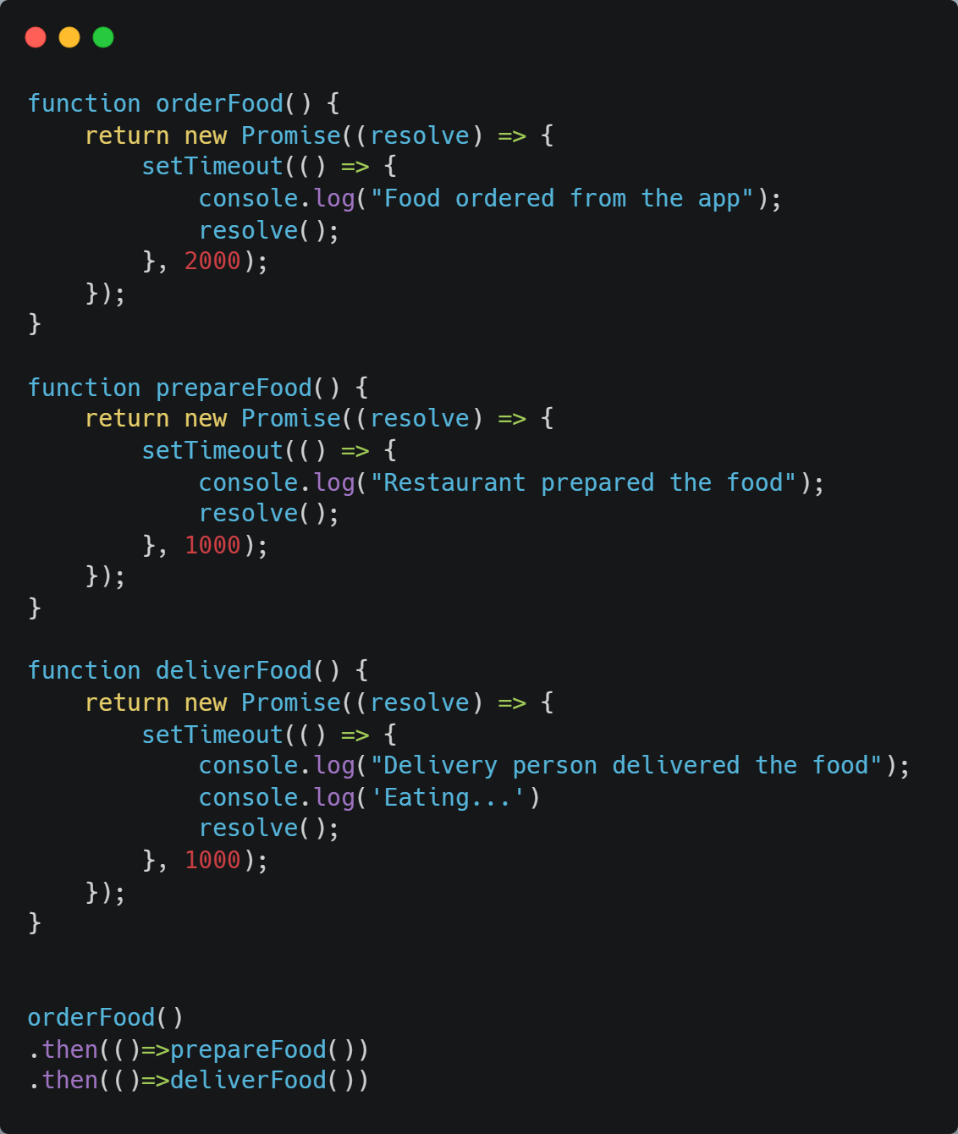
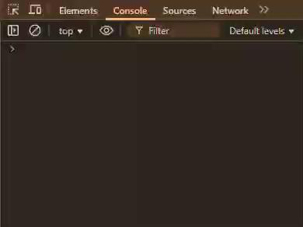
| async-await
Without using async-await
‹#›

Slide 9
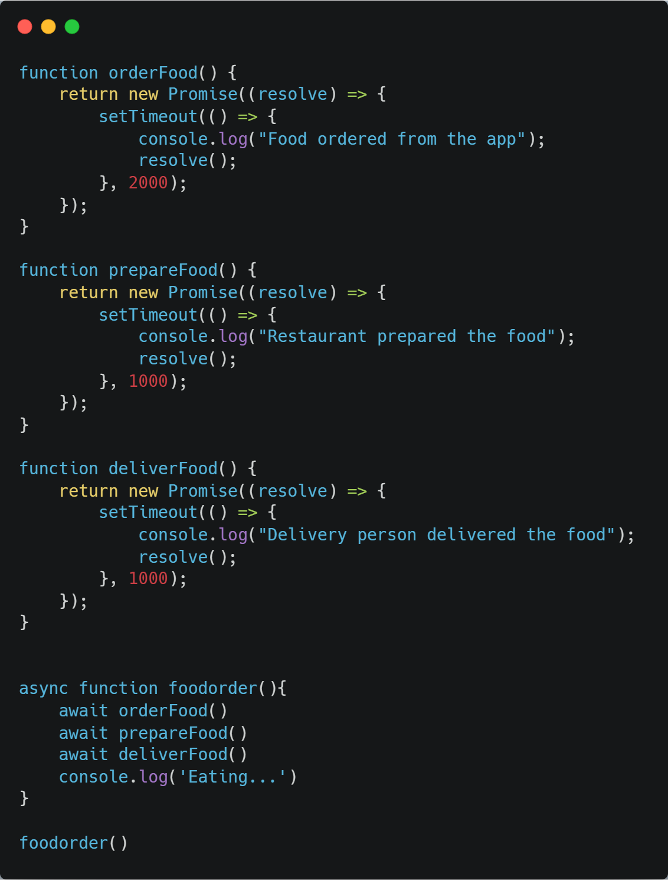
| async-await
Using async-await
‹#›

Slide 10

| Coding Questions
1. Simple async function
Task :
Write an async function named getGreeting that doesn't take any arguments and simply returns the string "Hello from async!". Then, call this function and use the .then() method to log the result to the console.
‹#›

Slide 11
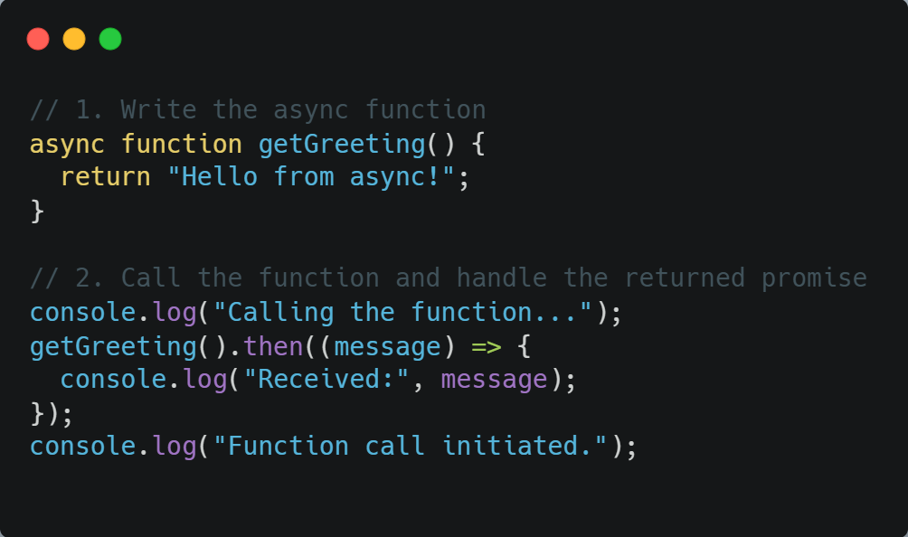
| Coding Questions
Solution :
‹#›

Slide 12
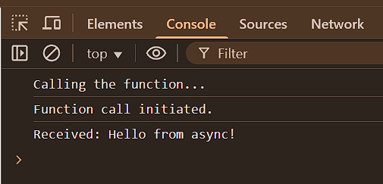
| Coding Questions
Output :
‹#›

Slide 13
| Check Your Understanding
Question : What does adding the async keyword before a function declaration do?
Options :a) It makes the function run synchronously.
b) It automatically makes all code inside it run faster.
c) It makes the function implicitly return a Promise.
d) It prevents the function from ever having errors.
Answer : c) It makes the function implicitly return a Promise.
Explanation:
An async function always wraps its return value in a Promise. If it returns a value, the promise resolves with that value. If it throws an error, the promise is rejected.
‹#›

Slide 14
| Check Your Understanding
Question : What is the purpose of the await keyword in JavaScript?
Options : a) To make a function wait indefinitely.
b) To pause the execution of an async function until a Promise is settled (resolved or rejected).
c) To define a callback function.
d) To immediately reject a Promise.
Answer : b) To pause the execution of an async function until a Promise is
settled (resolved or rejected).
Explanation:
await can only be used inside an async function. It "unpacks" the value from a resolved promise, allowing you to write asynchronous code that looks synchronous.
‹#›

Slide 15
| References
MDN Web Docs : Comprehensive and official documentation for JS. 🔗https://developer.mozilla.org/en-US/docs/Web/JavaScript
W3Schools – JS Tutorial : Beginner-friendly JS tutorials with examples and interactive editors. 🔗 https://www.w3schools.com/js/
JavaScript.info - A comprehensive tutorial-style website that covers core JavaScript concepts in depth.
🔗https://javascript.info/
‹#›

Slide 16

Thanks
For
Watching
Course - Web Development - II
‹#›
welcome@krmangalam.edu.in
Sohna Road,Gurugram,Haryana 122103

